Slide 1


Designing efficient key-value store/storage (KVS) on a single node
SE3331-1 (2023 Fall)
IPADS, Shanghai Jiao Tong University
https://www.sjtu.edu.cn
Credits: Niv Dayan， JiFei@IPADS

Slide 2
Review: GFS
A File is made of 64MB chunks, possibly spawn multiple machines
That are replicated for fault-tolerance
Chunks live on chunkservers
chunkserver
chunkserver
chunkserver
Used for fault tolerance, talked later
checkpoint image
operation log
The master manages the file system namespace
master
In-memory FS metadata

Slide 3
Reading a file in GFS (very similar to the naïve DFS)
Reading a file is simple in GFS
1. Contact the master
2. Get file’s metadata: chunk handles
3. Get the location of each of the chunk handles
Multiple replicated chunkservers per chunk
4. Contact any available chunkserver for chunk

Slide 4
Writing a File in GFS (More complicated due to replication)
Less frequent than reading
But is more complex, because we need to deal with the consistency issues
GFS adopts a relaxed consistency model (see later lectures)
E.g, may have inconsistency state, but work well for their apps
Benefits: simple & efficient to implement
Master grants a chunk lease to one of the replicas
This replica will be the primary chunkserver
The only one that can modify the chunk
Primary can request extensions (of lease), if needed
Master increases the chunk version number and informs replicas

Slide 5
Naming in GFS: simple flat naming
No per-directory data structure like most file systems
E.g., directory file contains names of all files in the directory
No aliases (i.e., no hard or symbolic links)
Namespace is a single lookup table
Maps pathnames to metadata

Slide 6
Review: GFS in Google cluster
Google cluster environment
Core services: GFS + cluster scheduling system
Typically, 100s to 1000s of active jobs
200+ clusters, many with 1000s of machines
Pools of 1000s of clients
4+ PB filesystems, 40GB/s read/write loads
Job-1
Job-2
Job-3
Chunk Server
Scheduling Slave
GFS Master
File system Master
. . .
Linux
Scheduling Master
Job Scheduler
Commodity Hardware

Slide 7











HDFS: another popular (open-source) DFS
Hadoop Distributed FS
Primary storage system for Hadoop apps
A framework that allows for the distributed processing of large data sets across clusters of computers

Slide 8
Design Goals & Assumptions of HDFS
HDFS is an open source (Apache) implementation inspired by GFS design
Similar goals as GFS
Run on commodity hardware
Highly fault tolerant
High throughput & large-scale deployments
…

Slide 9
Recall GFS files
A File is made of 64MB chunks, possibly spawn multiple machines
That are replicated for fault-tolerance
Chunks live on chunkservers
chunkserver
chunkserver
chunkserver
checkpoint image
operation log
The master manages the file system metadata
master
In-memory FS metadata

Slide 10
HDFS files
A File is made of 64MB blocks, possibly spawn multiple machines
That are replicated for fault-tolerance
Blocks live on DataNodes
DataNode
DataNode
DataNode
FSImage
EditLog
NameNode
The NameNode manages the file system metadata
In-memory FS metadata

Slide 11
Summary
Designing distributed file system (DFS) is not simply
Single-node file system + RPC
Many design choices for performance, consistency model & failure handling
Interface
Caching
Access model
Two case studies
NFS: transparent access files on a remote server
GFS: highly-scalable & fault-tolerant DFS optimized for Google’s workload

Slide 12
GFS or NFS are not Perfect
NFS
Can not scale
Is not fault-tolerant
But is well-enough for many workloads, e.g., sharing the data for experiments in our lab ☺
GFS
Relaxed consistency model: the results of concurrent mutations are undefined
Single-node master: single point of failures (though next-generation of GFS refines this, with more advanced techniques developed later)
Work well in Google’s datacenter workloads

Slide 13
GFS or NFS are not Perfect
NFS
Can not scale
Is not fault-tolerant
But is well-enough for many workloads, e.g., sharing the data for experiments in the lab
GFS
Relaxed consistency model: the results of concurrent mutations are undefined
Single-node master: single point of failures (though next-generation of GFS refines this)
Work well in Google’s datacenter workloads
We will see system principles to cope with them in future lectures.
For other workloads (e.g., Database) may not sufficient.

Slide 14
Review: Large-scale websites on distributed systems
While distributed systems are built from components on a single node
File system runtimes, etc.
Caching server
Caching server
Caching server
…
Caching
Caching
Caching
Distributed caching
Database server
Database server
CDN
Users
Application #1
generate the page
Database
user, price
…
Database
user, price
Application server
Distributed database
Internet
Load
Balance
Application #2
add the order
File server
File server
File server
File:
image
File:
image
…
File:
image
Application server
…
…
Message queue
Distributed file system

Slide 15
Review: The filesystem API
API
CHDIR, MKDIR
CREAT, LINK, UNLINK, RENAME
SYMLINK
MOUNT, UNMOUNT
OPEN, READ, WRITE, APPEND, CLOSE
SYNC
Implemented as system calls to user applications
Kernel has many sets of function pointers implementing the API
Each set is specific to a FS (chose at mount point)

Slide 16
Does filesystem API sufficient?

Slide 17

Recall: Different storage systems to support different type of data
Database
File system
Key-value store

Slide 18



Key-value storage (KVS): system w/ a simpler API
Storage abstraction:
Each data (Value) is opaque to the underlying storage/database
The K and V can be arbitrary byte-sequence (e.g., JSON, int, string)
Indexed by a key (K), which itself is also a data
Stored on disk (tolerate failure & support a large capacity)
Application-level Interface (API)
Get(K) -> V, Scan(K,N)
Update(K,V), Insert(K,V), Delete(K,V)
Notes:
实现这个 + 子集

Slide 19
Why key-value storage instead of filesystem?
1. Filesystem is designed for bulk storage
E.g., images, videos KV
For small data, we need a way to store them in one file to improve storage efficiency
But question remains: how can we find the data in a file efficiently?
2. Developers need a way to map abstract name to the concrete data
E.g., ”item name” -> number of views
They don’t need to take care of directory, etc.
Key-value store

Slide 20
Naïve solution to implement a KVS atop of filesystem
Storage abstraction remapping:
Key → The file name
Assume the key is not so long
Value → The file content
So we can store each K,V as a file ☺
Application-level Interface (API)
Get(K) -> V is similar to OPEN(…) + READ(…)
Insert(K,V) -> is similar to CREATE(…) + WRITE(…)
Etc.

Slide 21
Naïve implement a KVS on the filesystem is inefficient
Redundant system call caused by mismatched interface
Example
E.g., Get(K,V) needs OPEN(…) + READ(…)
Ideally, we want to query the data in one system call, better 0
Space amplification
File data are stored in fixed-sized blocks (e.g., 512B – 4096B)
Why? To match the underlying device block size
On the other hand, the value in key-value store can be small (e.g., 64B)

Slide 22
Naïve implement a KVS on the filesystem is inefficient
Redundant system call caused by mismatched interface
Example
E.g., Get(K,V) needs OPEN(…) + READ(…)
Ideally, we want to query the data in one system call, better 0
Space amplification
File data are stored in fixed-sized blocks (e.g., 512B – 4096B)
The value in key-value store can be small (e.g., 8B)
Idea: using one or few file to store key-value store data
Different key-values can pack into the same disk block
Reduce system call overhead: open file once, serve all the requests then
Notes:
// TODO: directory has maximum file entry supported?

Slide 23
Building Key-value Storage on File System
Why builds upon the file system?
We still need a system to interact with the disk hardware!
Though modern KVS may also bypass the file system, but is uncommon
“All problems in computer science can be solved by another level of indirection” -- often attributed to Butler Lampson, who attributes it to David Wheeler
Key-value Store
Key-value files
File system
Notes:
<Hints and Principles for Computer System Design>
David Wheeler： 剑桥大学

Slide 24
A naïve Key-Value Storage (KVS)
Suppose we store all the KV in a single file in the following format:
Key
Value
123456，'{"name":"London","attractions":["Big Ben","London Eye"]}’
42，'{"name":"San Francisco","attractions":["Golden Gate Bridge"]}’
...

Slide 25
Update(K,V) in the naïve KVS
Suppose we store all the KV in a single file in the following format:
Key
Value
123456，'{"name":"London","attractions":["Big Ben","London Eye"]}’
42，'{"name":"San Francisco","attractions":["Golden Gate Bridge"]}’
...
How to implement the update? It is simple:
Directly append update to the end of the file
procedure UPDATE(integer fd, character[] &key, character[] &value)

Slide 26
Update(K,V) in the naïve KVS
Suppose we store all the KV in a single file in the following format:
Key
Value
123456，'{"name":"London","attractions":["Big Ben","London Eye"]}’
42，'{"name":"San Francisco","attractions":["Golden Gate Bridge"]}’
...
How to implement the update? It is simple:
Directly append update to the end of the file
Benefits: update the file is efficient, if there are many updates, because disks are good at sequential writes
Overwrite the original content introduce slow random accesses

Slide 27
Insert(K,V) in the naïve KVS
Suppose we store all the KV in a single file in the following format:
Key
Value
123456，'{"name":"London","attractions":["Big Ben","London Eye"]}’
42，'{"name":"San Francisco","attractions":["Golden Gate Bridge"]}’
...
How about the insertion? The same s the update
Question: what about deletion?
Append a NULL entry and later garbage collected (will talk later)
Notes:
Append a null record at the end of the file

Slide 28
BTW: File format of naïve KVS & log file
The file format is some kind of log file
We called Log-structured file: an append-only sequence of records
Widely used in computer systems in various scenarios
Suits the performance of underlying hardware (e.g., disk)
E.g., ensure consistency under failure, etc.
We will see more examples in later lectures

Slide 29
Hardware speed matters!
In our case: disk.

Slide 30
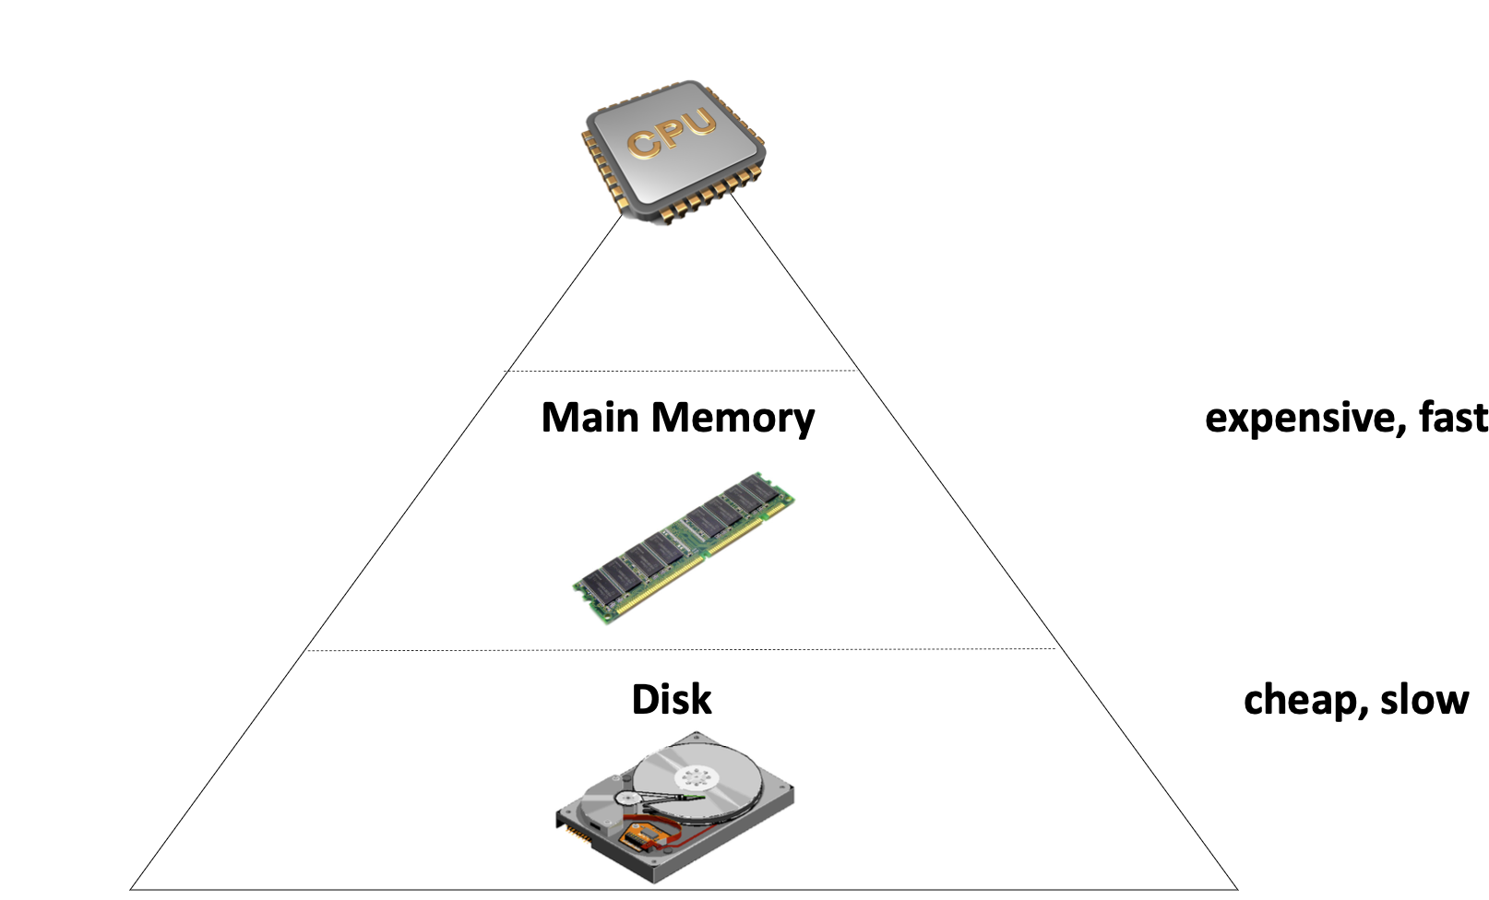
Storage Hierarchy
Fast device (e.g., Main Memory)
Fast, but capacity is limited
Expensive
Volatile
Disk has huge capacity
Cheap & slow
Non-volatile

Slide 31
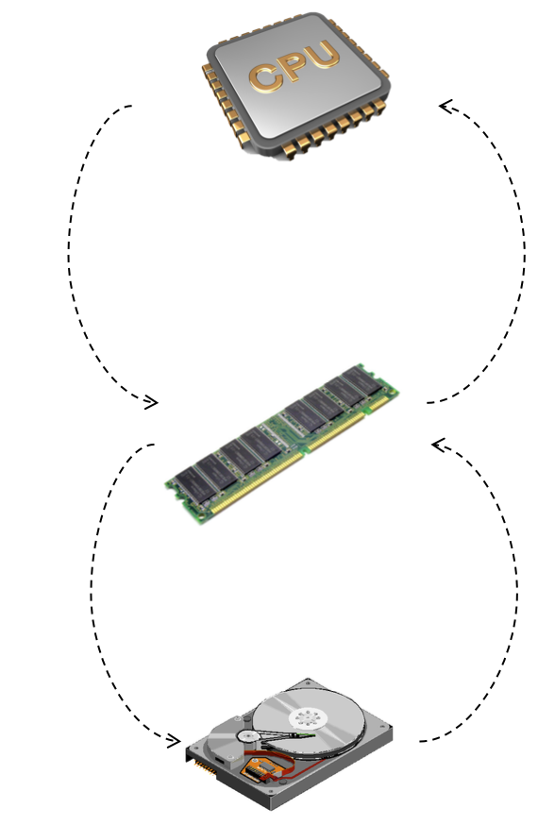
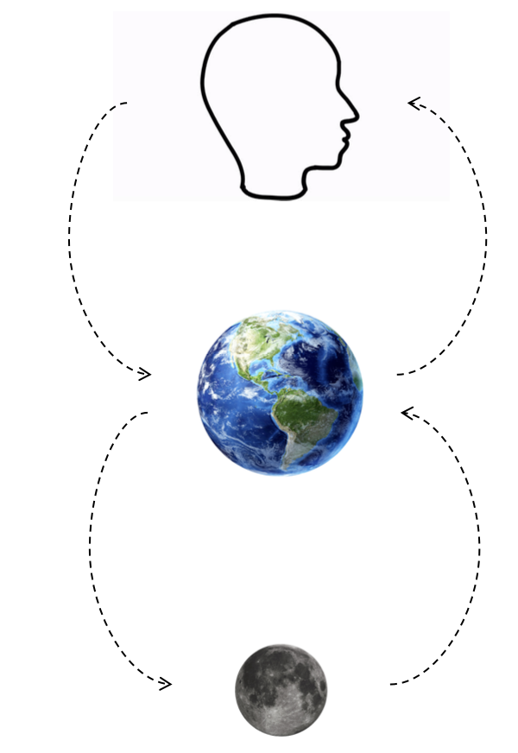
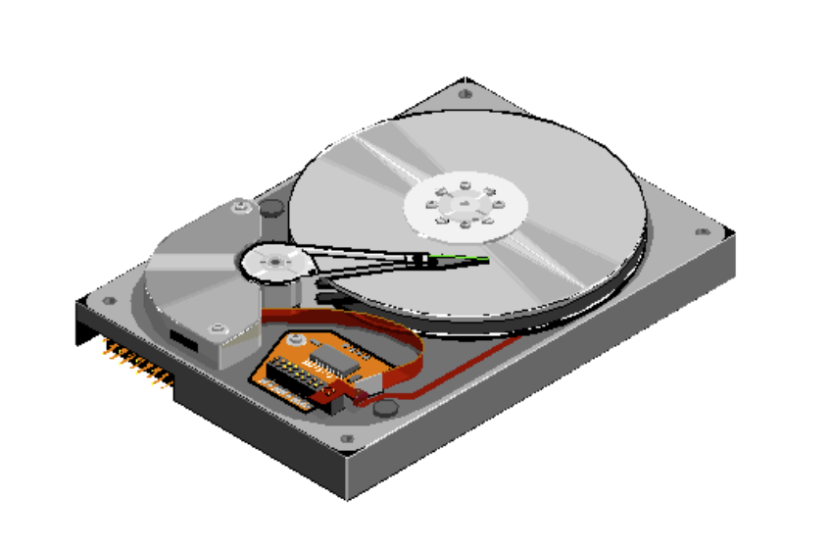
Storage Hierarchy: asymmetric performance of disk
CPU <-> Memory
~= 100ns
Memory <-> Disk
~= 10ms
Why disk is slow at random access?
Random: move disk header
Sequential: disk just spins
Disk Header

Slide 32
Updates work Well, What about Get(K,V)?
Suppose we store all the KV in a single file in the following format:
Key
Value
123456 '{"name":"London","attractions":["Big Ben","London Eye"]}’
42 '{"name":"San Francisco","attractions":["Golden Gate Bridge"]}’
...
Get is much tricky to implement
We need to iterate the file line by line starting at the end of file, and then finds the first line whose key matches K
Terrible performance! Complexity: O(n)

Slide 33
Principle: Accelerate Get with index
Index
An additional structure that is derived from the primary data (e.g., log file)
Can be added/removed without affecting the primary data
Only affects the performance instead of correctness
Example of index data structure:
B+Tree, HashTable, etc
The inode table in Lab1 is essentially an index; but is extremely simple. What are the trade-offs of an inode table?
Notes:
Lab1: direntry，类似tree

Slide 34
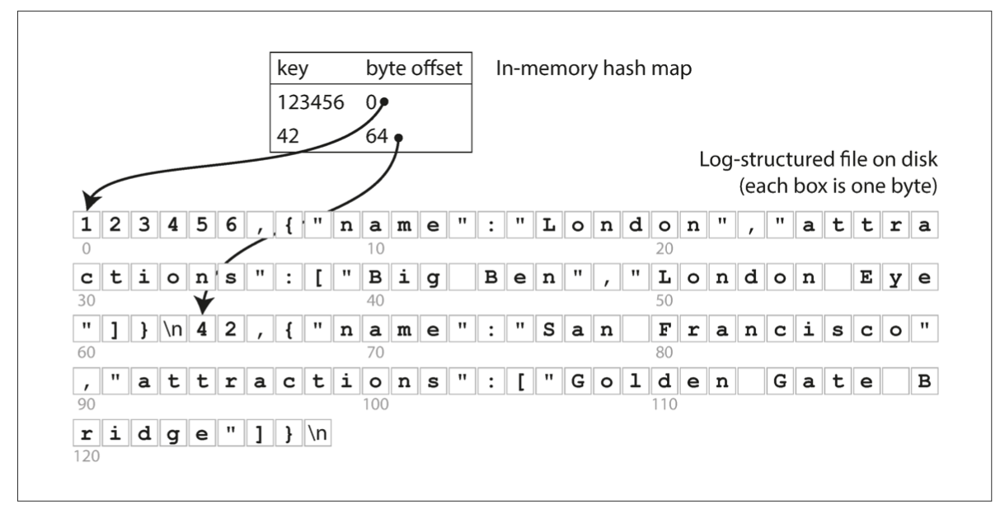
First try of index: an In-memory Hash Index
The simplest possible indexing strategy
Keep an in-memory hash map that map key -> byte offset in the log file

Slide 35

Hash index & log-structured data file
The simplest possible indexing strategy
Keep an in-memory hash map that map key -> byte offset in the log file
A viable solution
Adopted by commercial systems， e.g., Bitcask in riakKV
Benefits
High-performance of reads/writes
Restrictions?
Notes:
// 从文件访问角度来说下性能

Slide 36
Hash index & log-structured data file
The simplest possible indexing strategy
Keep an in-memory hash map that map key -> byte offset in the log file
A viable solution
Adopted by commercial systems， e.g., Bitcask in riakKV
Benefits
High-performance of reads/writes
Restrictions
Index must fit into the RAM
Only good at: when workloads have many updates but not insertions
Too many insertions will exhaust the RAM
Notes:
// 讲下

Slide 37
Hash Index++: Put it onto the disk
Question: how to choose the appropriate hash index data structure?
Many hash data structures exist
Their performance differences are not so different in an in-memory setting for KVS
But on disk, the things are different, because accessing the disk is orders of magnitude slower than the memory
Different hash indexes have different trade-offs when stored on disk
For a specific index, we need make some optimization to make it suit for the disk

Slide 38
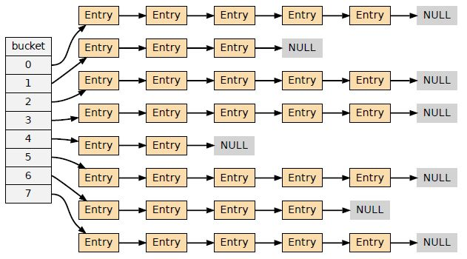
Linked-list based hash index
The simplest data structures
Pros:
Easy for implementation
Cons (of the easiest implementation):
Bad read performance under hash collision
Requires traverse the linked buckets in random I/O
Bad insert performance under hash collision
Similar problem as the read
Question: can you make it better?
Simple idea: put the entries in the same file block to reduce the chain length

Slide 39
Cuckoo hashing
Buckets0
Buckets1
Cuckoo hashing
Maintain two hash buckets
value
32
16
73
84
Notes:
解决hash colision的方法：采用两个bukcet

Slide 40
Cuckoo hashing
Buckets0
Buckets1
Cuckoo hashing
Maintain two hash buckets
Get()
Using two hash functions H0 & H1
The key must be in Buckets0[H0(key)] or Buckets1[H1(key)]
value
32
16
73
84

Slide 41
Cuckoo hashing
Buckets0
Buckets1
Cuckoo hashing
Maintain two hash buckets
Get()
Using two hash functions H0 & H1
The key must be in Buckets0[H0(key)] or Buckets1[H1(key)]
Example: Get(73)
Buckets0[H0(73)] = 2
value
32
16
73
?
84

Slide 42
Cuckoo hashing
Buckets0
Buckets1
Cuckoo hashing
Maintain two hash buckets
Get()
Using two hash functions H0 & H1
The key must be in Buckets0[H0(key)] or Buckets1[H1(key)]
Example: Get(73)
Buckets0[H0(73)] = 2 & Buckets1[H1(k73)] = 1
value
32
16
73
84

Slide 43
Cuckoo hashing
Buckets0
Buckets1
Cuckoo hashing
Maintain two hash buckets
Update()
Similar as Get()
1. find the bucket
2. update the value
value
32
16
73
84
What about insert?

Slide 44
Cuckoo hashing
Buckets0
Buckets1
Cuckoo hashing
Maintain two hash buckets
Insert()
Much complicated: should insert to Buckets0[H0(key)] or Buckets1[H1(key)]
Question: what if no available space?
value
32
16
73
84

Slide 45
Cuckoo hashing
Buckets0
Buckets1
Cuckoo hashing
Maintain two hash buckets
Insert()
Much complicated: should insert to Buckets0[H0(key)] or Buckets1[H1(key)]
Example: Insert(2)
Buckets0[H0(2)] = 0 & Buckets1[H1(2)] = 0
value
32
16
73
84

Slide 46
Cuckoo hashing
Can we insert here?
Buckets0
Buckets1
Cuckoo hashing
Maintain two hash buckets
Insert()
Much complicated: should insert to Buckets0[H0(key)] or Buckets1[H1(key)]
Example: Insert(2)
Buckets0[H0(2)] = 0 & Buckets1[H1(2)] = 0
value
32
16
73
84

Slide 47
Cuckoo hashing
Buckets0
Buckets1
Cuckoo hashing
Maintain two hash buckets
Insert()
Much complicated: should insert to Buckets0[H0(key)] or Buckets1[H1(key)]
Example: Insert(2)
Buckets0[H0(2)] = 0 & Buckets1[H1(2)] = 0
Insert here!
value
32
2
16
73
84

Slide 48
Cuckoo hashing
Buckets0
Buckets1
Cuckoo hashing
Maintain two hash buckets
Insert()
Much complicated: should insert to Buckets0[H0(key)] or Buckets1[H1(key)]
Example: Insert(9)
Buckets0[H0(9)] = 0 & Buckets1[H1(9)] = 0
value
32
2
16
73
84

Slide 49
Cuckoo hashing
Both slots are not empty!
Buckets0
Buckets1
Cuckoo hashing
Maintain two hash buckets
Insert()
Much complicated: should insert to Buckets0[H0(key)] or Buckets1[H1(key)]
Example: Insert(9)
Buckets0[H0(9)] = 0 & Buckets1[H1(9)] = 0
value
32
2
16
73
84

Slide 50
Cuckoo hashing
Buckets0
Buckets1
Cuckoo hashing
Maintain two hash buckets
Insert()
Much complicated: should insert to Buckets0[H0(key)] or Buckets1[H1(key)]
Example: Insert(9)
Buckets0[H0(9)] = 0 & Buckets1[H1(9)] = 0
Cuckoo hashing will kick others to different place to create space for the new insertions
value
32
2
16
73
84

Slide 51
Cuckoo hashing
Can insert 9 here!
Buckets0
Buckets1
Cuckoo hashing
Maintain two hash buckets
Insert()
Much complicated: should insert to Buckets0[H0(key)] or Buckets1[H1(key)]
Example: Insert(9)
Buckets0[H0(9)] = 0 & Buckets1[H1(9)] = 0
Cuckoo hashing will kick others to different place to create space for the new insertions
Kick 32 (Buckets0[0]) to another place
Assume: H1(32) = 2
9
2
16
73
32
84
value

Slide 52
Cuckoo hashing
Buckets0
Buckets1
Buckets0
Buckets1
Buckets0
Buckets1
32
2
2
9
2
16
73
16
73
16
73
32
32
84
84
84
Insert(9)
Kick(32)
Buckets0[H0(9)] = 0
& Buckets1[H1(9)] = 0
H1(32) = 2
Question: what if H1(32) = 3? (which is taken by 84)

Slide 53
Cuckoo hashing
Buckets0
Buckets1
Cuckoo hashing
Maintain two hash buckets
Insert()
Much complicated: should insert to Buckets0[H0(key)] or Buckets1[H1(key)]
Example: Insert(9)
Buckets0[H0(9)] = 0 & Buckets1[H1(9)] = 0
Cuckoo hashing will kick others to different place to empty
Kick 32 (Buckets0[0]) to another place
Question: what if H1(32) = 2 = 3?
32
2
16
73
84
value

Slide 54
Cuckoo hashing
Buckets0
Buckets1
Cuckoo hashing
Maintain two hash buckets
Insert()
Much complicated: should insert to Buckets0[H0(key)] or Buckets1[H1(key)]
Example: Insert(9)
Buckets0[H0(9)] = 0 & Buckets1[H1(9)] = 0
Cuckoo hashing will kick others to different place to empty
Kick 32 (Buckets0[0]) to another place
Kick 2 (Buckets1[0]) to another place
9
2
16
73
84
value

Slide 55
Cuckoo hashing
Buckets0
Buckets1
Cuckoo hashing
Maintain two hash buckets
Insert()
Much complicated: should insert to Buckets0[H0(key)] or Buckets1[H1(key)]
Example: Insert(9)
Buckets0[H0(9)] = 0 & Buckets1[H1(9)] = 0
Cuckoo hashing will kick others to different place to empty
Kick 2 (Buckets1[0]) to another place
Assume: H0(2) = 2
32
9
16
73
2
84
value

Slide 56
Cuckoo hashing
No available slots!
Buckets0
Buckets1
Cuckoo hashing
Maintain two hash buckets
Insert()
Much complicated: should insert to Buckets0[H0(key)] or Buckets1[H1(key)]
Example: Insert(9)
Buckets0[H0(9)] = 0 & Buckets1[H1(9)] = 0
Cuckoo hashing will kick others to different place to empty
Kick 2 (Buckets1[0]) to another place
Assume: H0(2) = 2 1 What if that happens?
32
2
16
73
84
value

Slide 57
Cuckoo hashing
Buckets0
Buckets1
Cuckoo hashing
Maintain two hash buckets
Insert()
Much complicated: should insert to Buckets0[H0(key)] or Buckets1[H1(key)]
If no available slots, rehashing & repeat the above insert process
Rehashing: enlarge the buckets (typically X2)

Slide 58
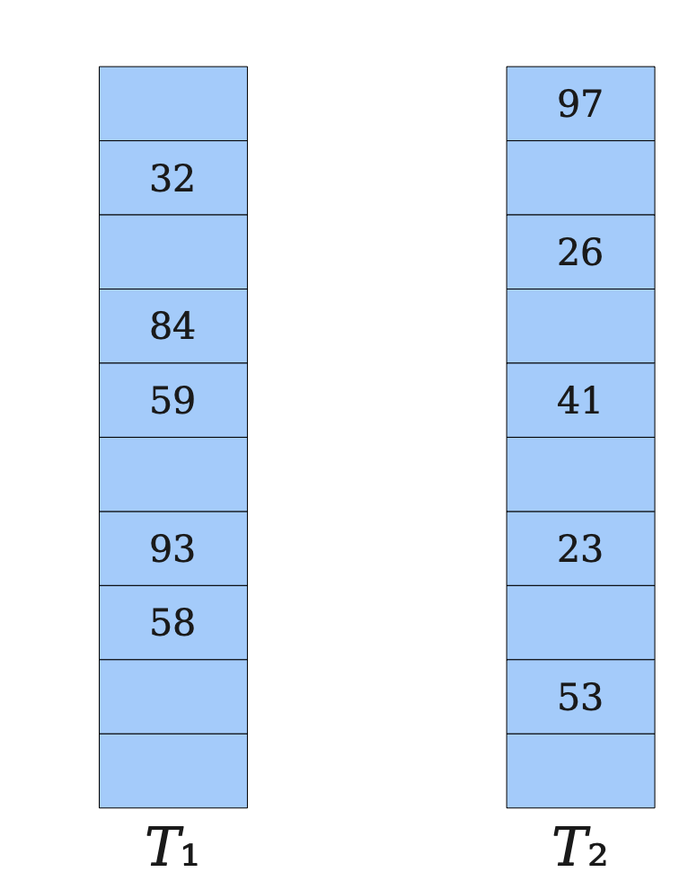
Cuckoo hashing
Cuckoo hashing
Two tables & Two hash functions (H₁, H₂)
The key can only at T₁[H₂(key)] or T₂[H₂(key)]
Pros
Good for read: at most two 2 random I/O for get
Cons
Insertion is complex and can issue many random disk I/O
Rehashing is required if there are many insertions, which is extremely slow
Expanding the table, and re-insert all the keys in the new table (!)
Notes:
We will not cover many details

Slide 59
Selecting a proper index for KV store is non-trivial
Not just choosing a data structure
Trade-offs of selecting indexes （ The RUM Conjecture[1]）
Read performance vs. update performance
An index needs to be updated upon inserts/deletions
Whether index is friendly to the storage?
E.g., random vs. sequential
Others (e.g., storage overhead)
Designing Access Methods: The RUM Conjecture, EDBT’16
Notes:
Read update memory overhead

Slide 60
Issues of using hash index & log file
Naïve in-memory hash index has a limited capacity
Can put it on the disk, but needs to carefully redesign the hash scheme or carefully select an appropriate hash scheme
Log file is growing forever -> running out of disk space
Lack range query support
E.g., scan over all keys between kitty00000 & kitty99999
Notes:
The RUM Conjecture

Slide 61
Issues of using hash index & log file
Naïve in-memory hash index has a limited capacity
Can put it on the disk, but needs to carefully redesign the hash scheme or carefully select an appropriate hash scheme
Log file is growing forever -> running out of disk space
Lack range query support
E.g., scan over all keys between kitty00000 & kitty99999

Slide 62
How to prevent a file from growing forever?
Log-structured design makes updates fast
Only append to the file
However, we will eventually run out of disk space
Since many duplicate records in the log file, we should have space to store more records
A deleted value is also left on the file

Slide 63
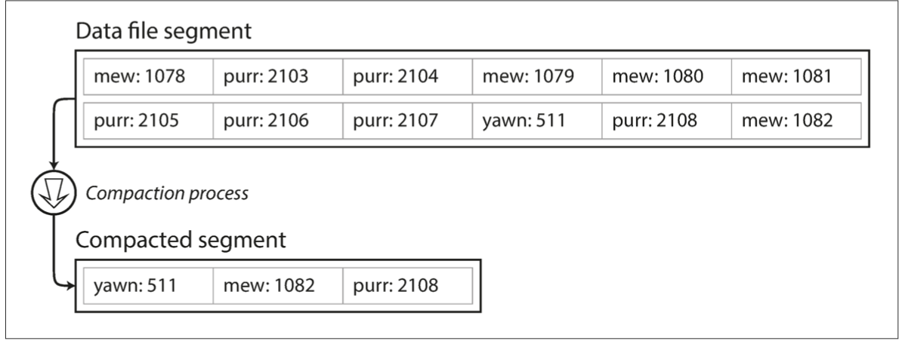
How to prevent a file from growing forever?
Solution: compaction
Scan the whole file, delete duplicate records and write to a new file
Question: what if the file is too large?

Slide 64
How to prevent a file from growing forever?
Solution: compaction with segmentation
Break a file into fixed-sized segments
If a segment is full, then create a new file for insertions
Can control the compaction granularity with the segment size
Notes:
遍历文件后面的block并不高效

Slide 65
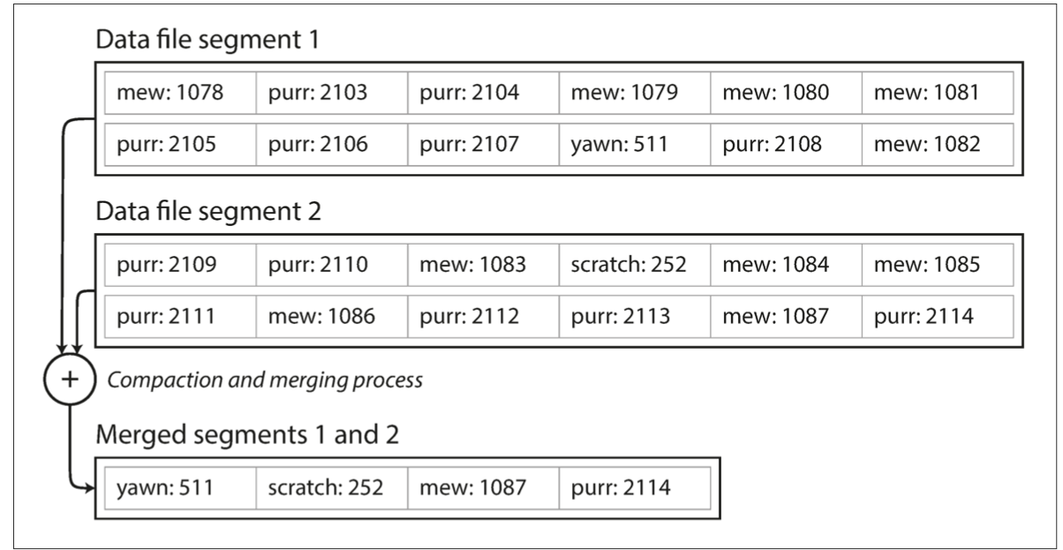
How to prevent a file from growing forever?
Solution: compaction with segmentation + Merge
Compact: remove duplicated records in a segmented file
Merge: merge two compacted segments into a new one
Why? Because compaction makes the segment smaller

Slide 66
Recall: how to handle delete() for log-structed file?
Append a NULL entry
Garbage-collected during compaction!
xxxx: null

Slide 67
Issues of using hash index & segmented log file
Naïve in-memory hash index has a limited capacity
Can put it on the disk, but needs to carefully redesign the hash scheme or carefully select an appropriate hash scheme
Log file is growing forever -> running out of disk space
Lack range query support
E.g., scan over all keys between kitty00000 & kitty99999
Notes:
支持range support的两个问题：
1） hash不支持range
2） log里面是无序的

Slide 68

B-Tree (B+Tree) indexes: a form of ordered index
Introduced in 1970, the “ubiquitous” index 10 years later for disk data
Standard data structures of many databases and key-value stores
“It could be said that the world’s information is at our fingertips because of B-trees”
Goetz Graefe Microsoft, HP Fellow, now Google
ACM Software System Award
Notes:
Fingertips: 唾手可得

Slide 69
B+Tree indexes
A B-tree is a tree-like data structure (one or a few files)
Each node is fixed-sized, can store multiple keys, and keys are sorted
Support efficient range operations (e.g., Scan)
Optimized for large read/write blocks of data
Many variants exist, e.g., B+Tree
All the leaf nodes of the B-tree must be at the same level
Simper to link leaf nodes to support range queries

Slide 70
B+Tree indexes example (fanout = 5)
13
2
3
8
13
27
Notes:
Fanout：指的是child节点的个数

Slide 71
B+Tree indexes example: Get(2)
13
2
3
8
13
27

Slide 72
B+Tree indexes example: Get(2)
13
2
3
8
13
27

Slide 73
B+Tree indexes example: Update(2)
Similar to Get()
1. find the position
2. update the value
13
2
3
8
13
27

Slide 74
B+Tree indexes example: insert(10)
13
2
3
8
13
27

Slide 75
B+Tree indexes example: insert(10)
13
2
3
8
10
13
27

Slide 76
B+Tree indexes example: insert(11)
13
2
3
8
10
11
13
27

Slide 77
B+Tree indexes example: insert(11)
10
13
2
3
8
10
11
13
27
Split the nodes!

Slide 78
B+Tree can support efficient range operations
Add a sibling link between the leaves
e.g., SCAN(3,5)
10
13
2
3
8
10
11
13
27

Slide 79
Question: need a B+Tree to index the values in the log?
No. It can store the values in its leave node
Which does not need compaction & merge
But, what are the costs?
10
13
2
3
8
10
11
13
27

Slide 80
B-Tree indexes on the disk?
Get(K), Insert(K,V) and Update(K,V) are slow
O(log(n)) random disk accesses
Typically, is small, since B-Tree indexes uses large node size. But is still a killer for performance
B+Tree indexes are not good enough for insertion-intensive workloads
Still many random disk I/O involved
Insertions are common for on-disk storages, because reads are served by other system components, e.g., a cache system like Memached
E.g., check lecture 02, step#2 for scaling a website
Notes:
// 分析B+Tree 索引的好坏
当然，如果insertion都是在最后，那么b树的性能也是很好的。

Slide 81
Can we avoid random access for
index updates and insertions ?

Slide 82
Recall: segmented log file
Compaction & segmentation
Break a file into fixed-sized segments
If a segment is full, then create a new file for insertions
Can control the compaction granularity with the segment size

Slide 83
LSM Trees: SSTables (Sorted String Table)
SSTable is based on the segmented log file described in the hash index
Break a file into fixed-sized segments
If a segment is full, then create a new file for insertion
Notes:
// 分析B+Tree 索引的好坏

Slide 84
LSM Trees: SSTables (Sorted String Table)
SSTable is based on the segmented log file described in the hash index
Break a file into fixed-sized segments
If a segment is full, then create a new file for insertion
With two extensions
Key-values in a segment are sorted by the key
Old segment files are immutable and can be compacted to save spaces
Why immutable? Inserting in a SSTable is not append-only
We will come back to this topic later
Notes:
// 分析B+Tree 索引的好坏

Slide 85
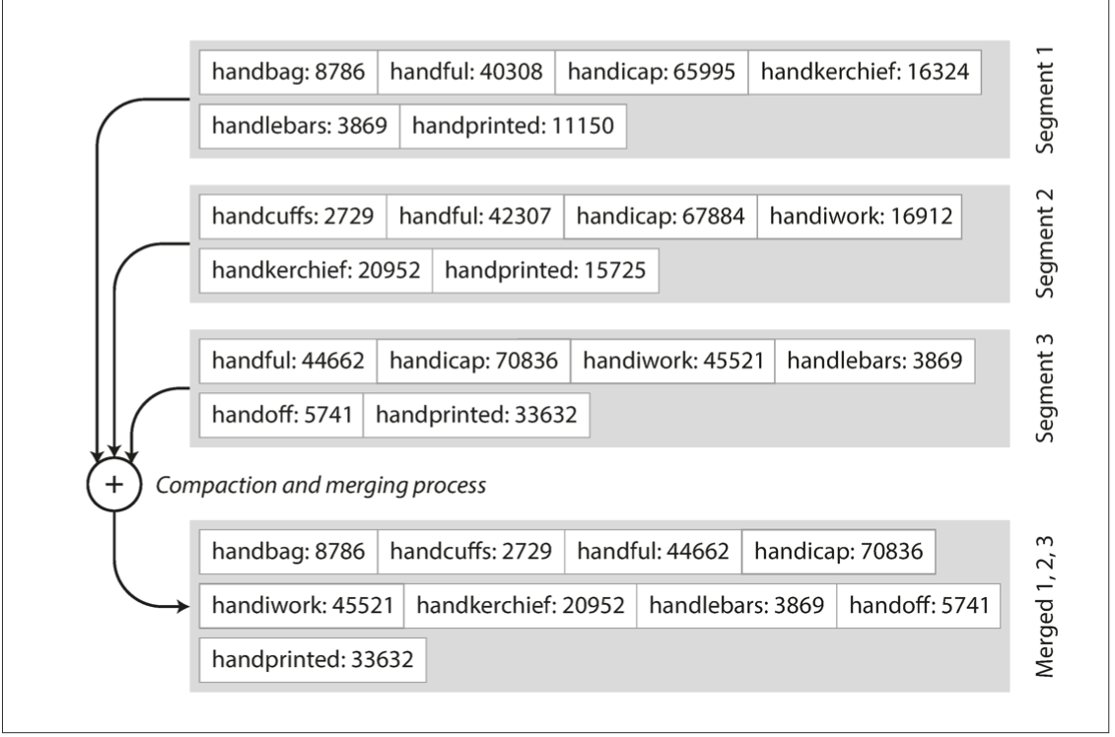
Benefits of SSTable (compared to original log file)
#1. Merging two SSTables is efficient
Even if the two tables are much larger than the available memory
Similar to the mergesort

Slide 86
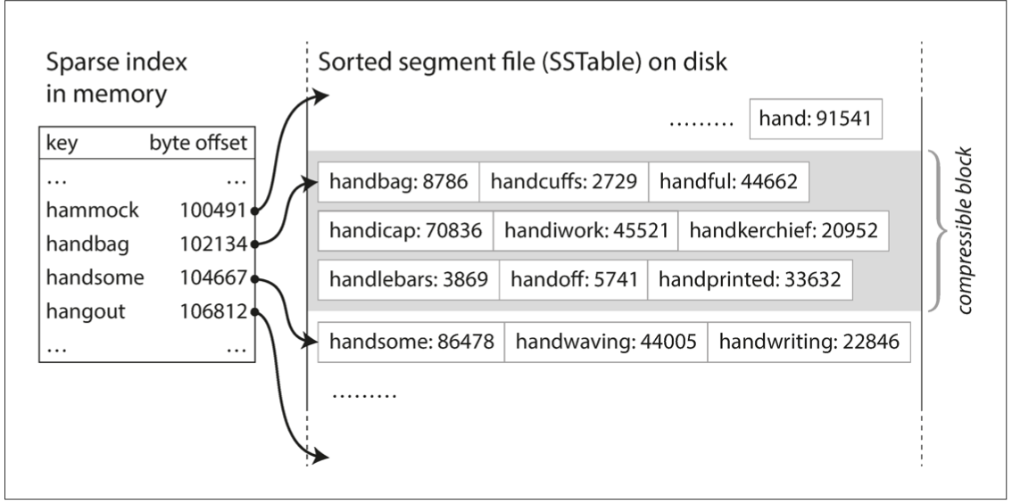
Benefits of SSTable (compared to original log file)
#2. Searching a given key in a SSTable is efficient
We can use binary search to lookup a given key
Or we only need some sparse index for the acceleration, one for each SSTable
E.g., one key in index for every few KB of SSTable is sufficient, since scanning them is quick

Slide 87
Benefits of SSTable (compared to original log file)
#3. Support range operations
Since the KVS are sorted in the file

Slide 88
How to maintain SSTable with sequential writes?
Use a MemTable: an in-memory data structure (e.g., a red-black Tree)
Simple quiz: why not using hash table?
MemTable

Slide 89
How to maintain SSTable with sequential writes?
Use a MemTable: an in-memory data structure (e.g., a red-black Tree)
Example: insert a (K, V) into SSTable
1
Insert the (K,V) into the MemTable
(K,V)
MemTable

Slide 90
How to maintain SSTable with sequential writes?
Use a MemTable: an in-memory data structure (e.g., a red-black Tree)
Example: insert a (K, V) into SSTable
1
Insert the (K,V) into the MemTable
(K,V)
Question: does writing to SSTable sequential?
MemTable
SSTable
2
check whether MemTable exceeds some threshold,
If so, flush it to a new SSTable

Slide 91
How to maintain SSTable with sequential writes?
Use a MemTable: an in-memory sorted data structure (e.g., red-black Tree)
Example: insert a (K, V) into SSTable
3
What if there are too many SSTables?
We can merge & compact them as we have done before with segmented log files
SSTables
Merge & compact

Slide 92
Reads with MemTable + SSTable
Checks the MemTable
If misses, checks the latest SSTable
If still misses, checks the next older SSTable
…
Optimization: keep a sparse index on each SSTable to accelerate the lookup
1
2
3
4
…
MemTable
SSTables

Slide 93
Question: what are the drawbacks of
such a design?

Slide 94
Organizing data sequentially has several drawbacks
#1. Finding the old value is slow
#2. Cannot support efficient scan
New
Old
1
2
3
4
…
MemTable
SSTables

Slide 95
LSM Tree organizes SSTables in a hierarchy
The famous Log-structured merge tree
Each layer has the entire KVS data of some time
Each layer has maximum size
Except L0, all files in layers are sorted, and does not have duplicated keys
New
MemTable
L0
L1
L2
LSM Tree
Old

Slide 96
Hierarchy can speed up old value lookup
Each layer has only one file that store the key (except L0)
So we can search only one file per-layer (not per-file search)
Question: how to find the key file?
Many methods exist
E.g., store a [min, max] per file in memory
Read upon lower layers
First identify the file, then look it!
O(1) access per layer
MemTable
New
L0
L1
L2
LSM Tree
Old
Notes:
Each layer has only one

Slide 97
Hierarchy can speed up range query
Store a [min, max] per file
Range query
Query layer-by-layer
Then merge the results
New
MemTable
L0
L1
L2
LSM Tree
Old
Notes:
Each layer has only one

Slide 98
Range Query in LSM Tree
Search each layer using binary search
Merge the results of each layer
Not as good as B+Tree,
but is much better than hash & logs without hierarchy! !
New
MemTable
L0
L1
L2
LSM Tree
Old

Slide 99
Example: Read in LSM-Tree (Similar to SSTables)
MemTable
Key
Memory
Disk
Level₀
…
…
SSTable
Level₁
KV pairs
(sorted)
…
Level_{k}
…
Metadata

Slide 100
Example: Read in LSM-Tree
MemTable
KV pairs
Memory
Disk
…
Search L0 sequentially
Level₀
…
SSTable
Level₁
KV pairs
(sorted)
…
Level_{k}
…
Metadata

Slide 101
Example: Read in LSM-Tree
MemTable
KV pairs
Memory
Disk
…
Search L0 sequentially
Level₀
…
SSTable
Level₁
KV pairs
(sorted)
…
Level_{k}
…
Metadata
Notes:
为啥L0没有sorted？主要是为了快速将 memtable 刷到 l0里去，不能成为性能瓶颈

Slide 102
Example: Read in LSM-Tree
MemTable
KV pairs
Memory
Disk
Search lower layer using binary search
Level₀
…
…
SSTable
Level₁
KV pairs
(sorted)
…
Level_{k}
…
Metadata

Slide 103
Example: insert/update in LSM-Tree
MemTable
KV pairs
Full
Memory
Disk
Level₀
…
…
SSTable
Level₁
KV pairs
(sorted)
…
Level_{k}
…
Metadata

Slide 104

Example: insert/update in LSM-Tree
MemTable
KV pairs
Memory
Disk
Level₀
…
Compaction
…
SSTable
Level₁
KV pairs
(sorted)
…
Level_{k}
…
Metadata

Slide 105
What about crash?
MemTable is an in-memory data structure
So it is vulnerable to machine failure
Goal: a successful insertion will store the data durably
Solution:
Keep a separate log file the MemTable (may not be sorted)
Before inserting to the MemTable, adding the KV to the log first (also a sequential write); reply if the log is successful
If the machine crashed, reboot it, and reconstruct the MemTable from the log

Slide 106




LSM Tree Summary
Good when
Massive dataset
Rapid updates/insertions
Fast single-point lookup for recently updated data
Widely adopted in modern single-node key-value stores

Slide 107
LSM Tree Summary
Good when
Massive dataset
Rapid updates/insertions
Fast single-point lookup for recently updated data
Compared with B-Tree
Pros: good write performance due to sequential writes
Cons: additional compaction process, possible slow range queries,
write stall caused by the compaction, slow lookup for non-existent key

Slide 108
LSM Tree Summary
Good when
Massive dataset
Rapid updates/insertions
Fast single-point lookup for recently updated data
Compared with B-Tree
Pros: good write performance due to sequential writes
Cons: additional compaction process, possible slow range queries,
write stall caused by the compaction, slow lookup for non-existent key

Slide 109
Write stall caused by compaction in LSM Tree
MemTable
KV pairs
Memory
Disk
Level₀
…
…
SSTable
Level₁
KV pairs
(sorted)
…
Level_{k}
…
Metadata

Slide 110
Write stall caused by compaction in LSM Tree
MemTable
KV pairs
Memory
Disk
Level₀
…
…
SSTable
Level₁
KV pairs
(sorted)
…
Level_{k}
…
Metadata

Slide 111
Write stall caused by compaction in LSM Tree
MemTable
KV pairs
Full
Memory
Disk
Level₀
…
…
SSTable
Level₁
KV pairs
(sorted)
…
Level_{k}
…
Metadata

Slide 112
Write stall caused by compaction in LSM Tree
MemTable
KV pairs
Memory
Disk
Level₀
…
Compaction
…
SSTable
Level₁
KV pairs
(sorted)
…
Level_{k}
…
Metadata

Slide 113
Write stall caused by compaction in LSM Tree
MemTable
KV pairs
Memory
Disk
Level₀
…
Compaction
…
SSTable
Level₁
KV pairs
(sorted)
…
Level_{k}
…
Metadata

Slide 114
Write stall caused by compaction in LSM Tree
MemTable
KV pairs
Full
Memory
Disk
Level₀
…
Compaction
…
SSTable
Level₁
KV pairs
(sorted)
…
Level_{k}
…
Metadata

Slide 115
Write stall caused by compaction in LSM Tree
MemTable
KV pairs
Memory
Disk
Level₀
…
Compaction
…
SSTable
Level₁
KV pairs
(sorted)
…
Level_{k}
…
Metadata

Slide 116

Write stall caused by compaction in LSM Tree
Stalled due to
slow compaction
MemTable
KV pairs
Full
Memory
Disk
Level₀
…
Compaction
…
SSTable
Level₁
KV pairs
(sorted)
…
Level_{k}
…
Metadata

Slide 117
How to avoid write stall?

Slide 118
In principle, hard to prevent
Can only alleviate
E.g., speed up compaction & merge process with advanced hardware
Disk
Level₀
…
Compaction
…
SSTable
Level₁
KV pairs
(sorted)
…
Level_{k}
…
Metadata

Slide 119
In principle, hard to prevent
Can only alleviate
E.g., speed up compaction & merge process with advanced hardware
Observation: SSD is much faster than disk on storage
Using it to store up-layer SSTables
SSD
…
Compaction
Level₀
Disk
…
SSTable
Level₁
KV pairs
(sorted)
…
Level_{k}
…
Metadata

Slide 120
LSM Tree Summary
Good when
Massive dataset
Rapid updates/insertions
Fast lookups
Compared with B-Tree
Pros: good write performance due to sequential writes
Cons: additional compaction process, possible slow range queries,
write stall caused by the compaction, slow lookup for non-existent key

Slide 121
Slow lookup for non-existent key
Question: what if the key non-exist?
Recall: how LSM Tree lookup keys
Checks the MemTable
If misses, checks the latest SSTable
If still misses, checks the next older SSTable
…
Will lookup all the files!
1
2
3
4
…
MemTable
SSTables
Notes:
Solution: bloom filter

Slide 122
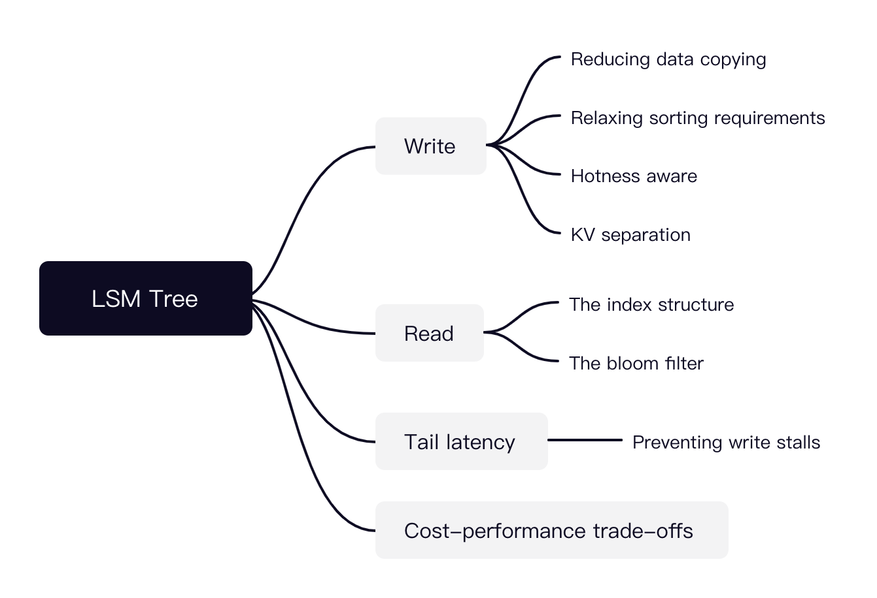
LSM Tree is a hot research topic today
Many possible directions

Slide 123
Key-value storage is a key component in large-scale website

Slide 124



Review: large-scale websites
Key-value storage is the key pillar
Caching server
Caching server
Caching server
…
Caching
Caching
Caching
Distributed caching
w/ MyRocks
Storage
- LSM Tree
Database server
Database server
CDN
Users
Application #1
generate the page
Database
user, price
…
Database
user, price
Filesystem
Application server
Distributed database
Internet
Load
Balance
Application #2
add the order
File server
File server
File server
File:
image
File:
image
…
File:
image
Application server
…
…
Message queue
Distributed file system

Slide 125
Distributed key-value storage

Slide 126
Distributed key-value storage
Make KV store distributed (see later lectures)
RPC + key-value storage = distributed key-value storage!
See the next lecture
We can also shard the data across multiple nodes
i.e., high scalability
Key challenge:
How to find the data?
E.g., consistent hashing
Other problems:
Fault tolerance (see later lectures)
Availability, replication & consistency (see later lectures)

Slide 127
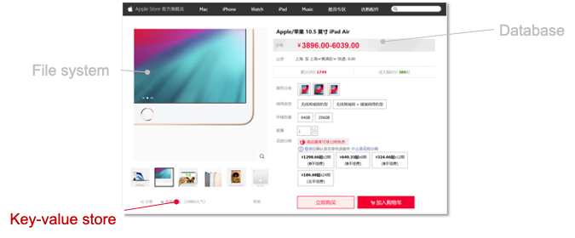
Summary of this lecture
Key-value store is an important component in computer systems
Typically built upon a filesystem to simplify disk hardware management
We show how KVS is evolved from log-structured file to the LSM tree
Log-structured file
Indexing
LSM Tree
Key-value Store
Key-value files
File system

